Slide 1






JavaScript: ExpressJS Overview
Node.js, ExpressJS Framework, MVC in JavaScript, Handlebars
ExpressJS
SoftUni Team
Technical Trainers
Software University
http://softuni.bg

Slide 2
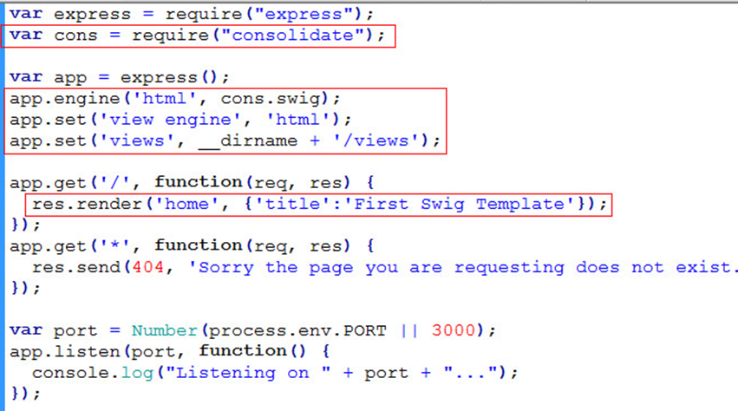

Table of Contents
Node.js
JS on the Server: Overview, Purpose, Installation
ExpressJS
What is ExpressJS?
MVC with ExpressJS
Routes
Controllers
Views – using handlebars.js

Slide 3
Have a Question?
sli.do #tech-softuni

Slide 4
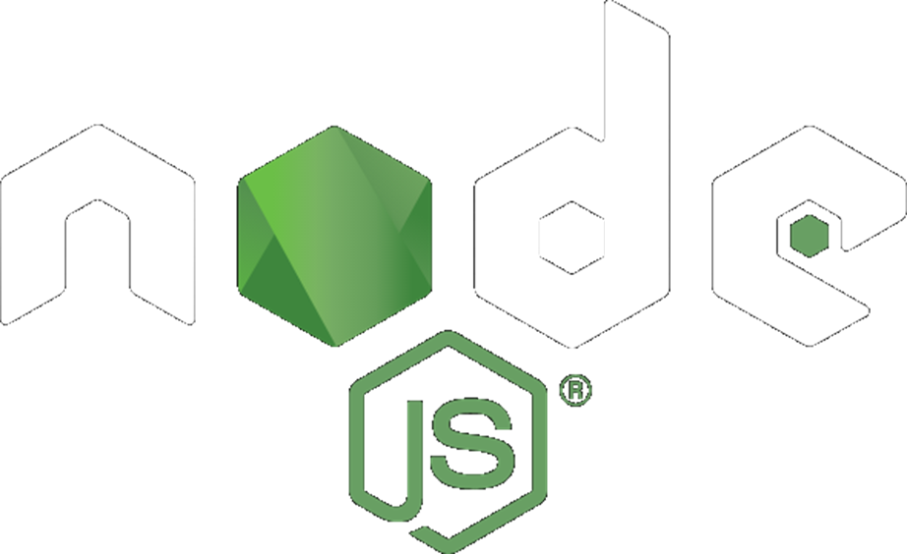
Node.js
The Server-Side JavaScript Runtime

Slide 5
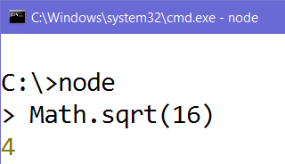
Node.js – What is It?
Node.js – JavaScript server-side runtime environment
Run JavaScript from the console
Flexible: use various modules
Scalable: works well for both small and large workloads
Can act as a Web server

Slide 6
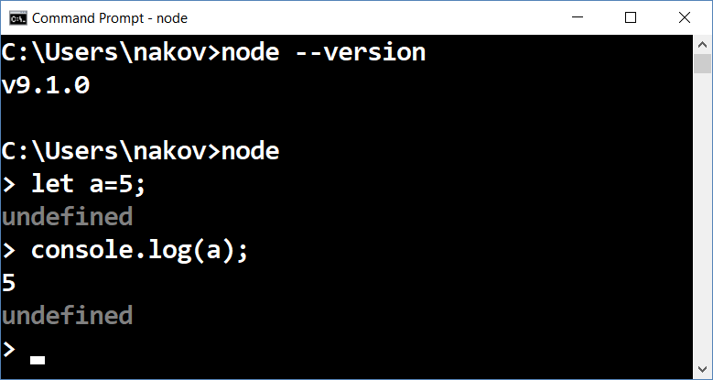
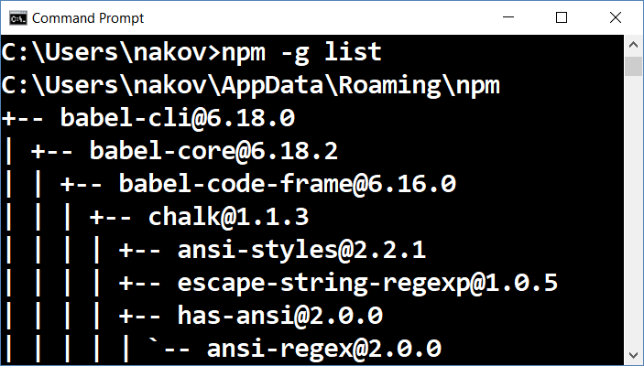
Installing Node.js
Install the Node.js environment from https://nodejs.org
Choose the latest version for your platform
Test the node and npm commands in the console

Slide 7
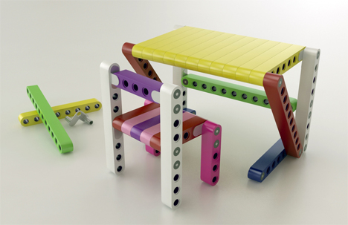
Node.js – Advantages
Developers can use whatever they want for:
Middleware
Authentication, Cookies, Sessions (User Login State)
Database connection + ORM (DB to Entity)
Mongoose, Sequelize, Bookshelf, etc.
Template (view) engines
Handlebars, Pug, Mustache, etc.

Slide 8
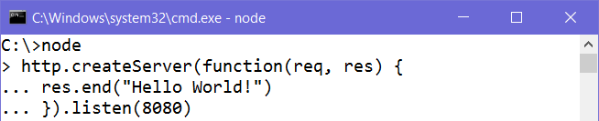
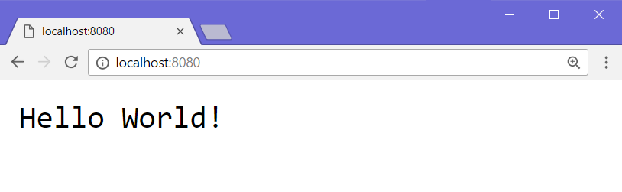
Node.js Example – Simple Web Server
Anonymous function
Send a response
Listen on port 8080
Request URL
HTTP Response
(rendered as web page)

Slide 9
ExpressJS
Web Framework for Node.js

Slide 10


What is ExpressJS?
Web framework for Node.js
Handles GET / POST HTTP requests
Error handling (bad request, not found, unauthorized)
Advanced routing (parameters and wildcards supported)
Parameters
Wildcard (anything)
Parameters

Slide 11
Getting Started with ExpressJS
Install the ExpressJS framework with NPM
http://expressjs.com/en/starter/installing.html
Create a very simple ExpressJS app
http://expressjs.com/en/starter/hello-world.html
Play with the basic routing in ExpressJS
http://expressjs.com/en/starter/basic-routing.html

Slide 12
ExpressJS Routing
Express can listen on different routes
Execute different functions, based on route:
Specify HTTP Request method (GET / POST)
Function to execute when the route is matched
Express instance
URI (path on server)
Request & Response

Slide 13
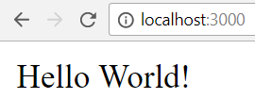
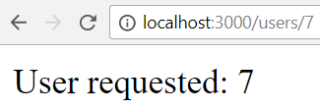
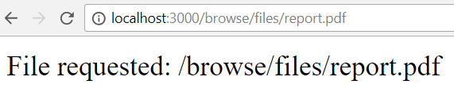
ExpressJS Routing – Example
app.get('/', (req, res) => {
res.send('Hello World!')
});
app.get('/users/:id', (req, res) => {
res.send('User: ' + req.params.id)
});
app.get('/browse/files/*', (req, res) => { res.send(
'File requested: ' + req.path)
});

Slide 14


MVC with ExpressJS
Using Node.js, ExpressJS, Handlebars, Mongoose

Slide 15
Routes – routes.js
The file config/routes.js allows us to tell ExpressJS which routes trigger which controller action
const homeController = require('./../controllers/home');
const catController = require('./../controllers/cat');
module.exports = (app) => {
app.get('/', homeController.index);
app.get('/cat/details/:id', catController.details);
};
Import the cat controller
Handles GET requests
Route to listen on
Call the details function

Slide 16
Model – Mongoose
Using Mongoose, we can define our model schema:
let catSchema = mongoose.Schema({
id: Schema.Types.ObjectId,
name: {type: String, required: true},
age: {type: Number, min: 0, max: 100},
isAlive: Boolean
});
let Cat = mongoose.model('Cat', catSchema);
Unique ID
Validation
Model properties
Model name

Slide 17
View – Handlebars
HTML views with Handlebars templating syntax:
<div class="container body-content">
<div class="row">
<h2>{{cat.name}}</h2>
<p>Age: {{cat.age}}</p>
{{#if cat.isAlive}}
<p>Status: Alive</p>
{{else}}
<p>Status: Deceased</p>
{{/if}}
</div>
</div>
Handlebars syntax
HTML Code
Handlebars if/else

Slide 18
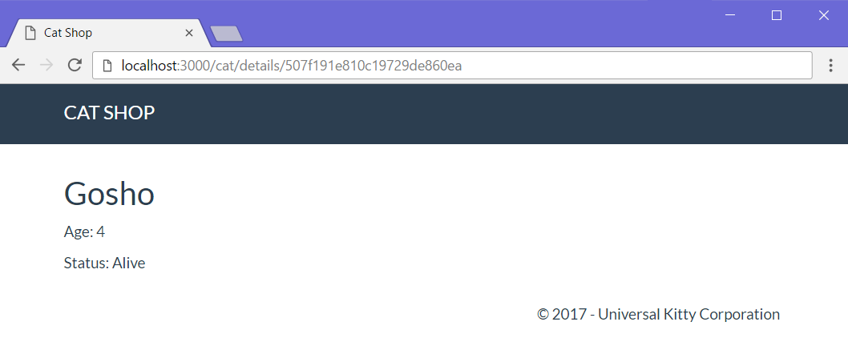
View – Handlebars (2)
Route: /cat/details/
req.params.id
{{cat.name}}
{{cat.age}}

Slide 19
Controller – ExpressJS
Import the Cat model
Example – catController.js:
const Cat = require('mongoose').model('Cat');
module.exports = {
catdetailsGet: (req, res) => {
let id = req.params.id;
Cat.findById(id).then(cat => {
if (!cat) {
res.render('error', { errorMsg: '404: Cat Not Found!' });
}
res.render('cat/details', { cat: cat });
});
};
};
Controller action
Find cat in DB by id
Render error view
Render cat/details view
Pass parameters to view

Slide 20
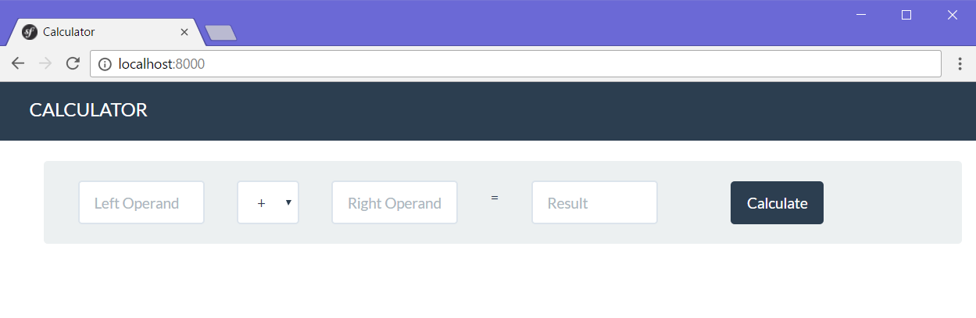
Problem: Simple Calculator Web Application
Write a web application, which can calculate the result between two operands
Implement addition, subtraction, multiplication and division

Slide 21

Web Application with ExpressJS
Live Exercises in Class (Lab)

Slide 22


Summary
Node.js
JavaScript runtime environment
Establishes communication between the server, and the client
ExpressJS
Web framework for Node.js
Implementing the MVC pattern with JavaScript
Using Node.js, Mongoose, ExpressJS and Handlebars

Slide 23







JavaScript: ExpressJS Overview
https://softuni.bg/courses/software-technologies

Slide 24
License
This course (slides, examples, demos, videos, homework, etc.) is licensed under the "Creative Commons Attribution-NonCommercial-ShareAlike 4.0 International" license

Slide 25





Trainings @ Software University
Software University Foundation – softuni.org
Software University – High-Quality Education, Profession and Job for Software Developers
softuni.bg
Software University @ Facebook
facebook.com/SoftwareUniversity
Software University Forums – forum.softuni.bg

